Slide 1
On my Ancestor’s Footsteps
Louis “dit Le Sabotier” Guertin
~France 2012~

Slide 2
…First a little history…
In 1651 the new outpost of Ville Marie (Montreal) is on the verge of being abandoned. The population is reduced to only 50 inhabitants and the Iroquois Indians are constantly attacking. It’s within this context that Governor Paul de Chomedey de Maisonneuve leave for France with the goal of bringing back at least 100 men to save Ville Marie and in doing so saving Nouvelle France
With the help ofJérôme le Royer de la Dauversière he signs up153 men to a contract of 3 to 5 years. Most of these new recruits including Louis Guertin come from the region of La Flèche in the Loire valley.
Of these153 men 50 will not show up at the time of departure.

Slide 3
…a little more…
14 women were also part of the voyage including 3 nuns. Marguerite Bourgeoys was one of them. She became Ville-Marie first school teacher and she cared for the sick and the elderly. She founded a religious order: the Congregation of Notre-Dame and in 1982 was canonised becoming Canada’s first female saint.
The men from La Flèche left on small boats from the Le Loir river to join the others at Saint-Nazaire (west of Anger on the Atlantic ocean) They boarded the ship Saint-Nicolas-de-Nantes.
The ship left port on the 20th of June 1653.
They arrived at Ville Marie on the16th Novembre 1653 after a 2 month stopover at Québec.
“Ces cent hommes ont sauvé l’île de Montréal et tout le Canada aussi” ( These hundred men saved Montreal Island and all of Canada as well ) A quote from Marquis de Denonville Governor of Nouvelle France 1685-1689.

Slide 4
…Louis Guertin…
Louis “dit le Sabotier” Guertin was born and baptised in the village of Daumeray near La Flèche on the 28th ofJune 1625. Son of Louis Guertin and Georgine Le Duc.
At the time of his departure for Ville-Marie he was living in Parcé-sur-Sarthe just north of La Flèche.
Louis married Élisabeth LeCamus on the 26th of October 1659 at Ville-Marie. Together they had11 childrens.
Louis died and was buried at Pointe-aux-Trembles, Quebec,Canada on the 8th of December 1687.
Louis and Élisabeth are responsable for all the Guertin in North America (and Australia).

Slide 5
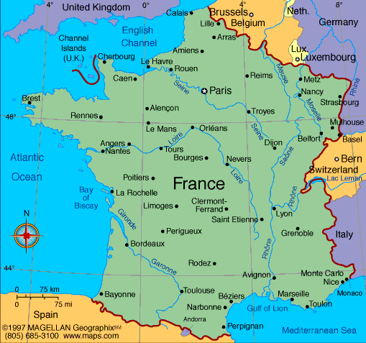
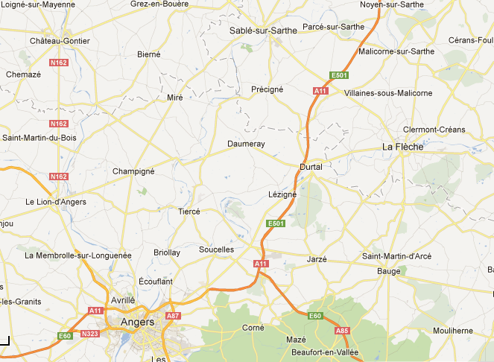

Slide 6
So here is a snapshot of my discovery in my ancestor’s country in Mai 2012 Pascal

Slide 7
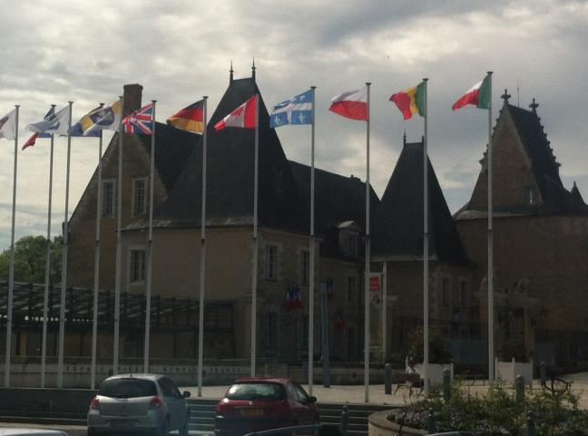
La Flèche’s Town Hall in the Loire Valley. We can see the Québec and Canada flags

Slide 8
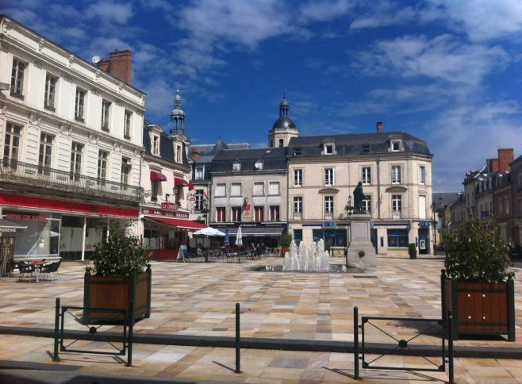
La Flèche’s town square

Slide 9
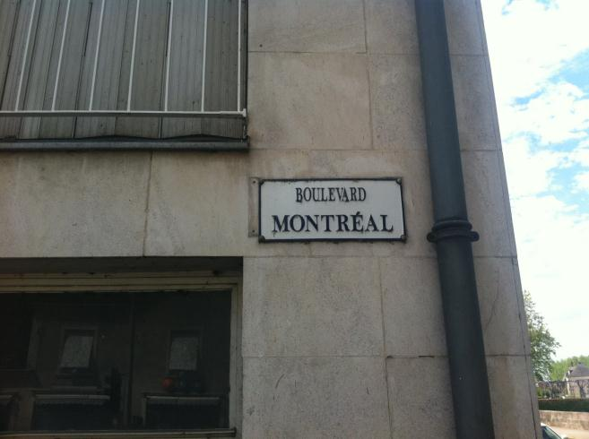
Montréal Boulevard is one of the main roads in downtown La Flèche. There is also a Québec and a Canada boulevard in the suburbs.

Slide 10
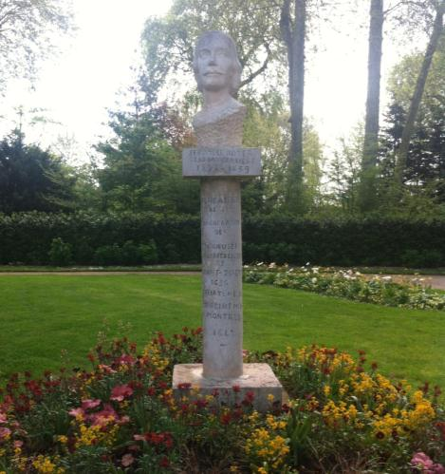
Bust to honor Jérôme Le Royer de la Dauversière located in the Parc des Carmes in La Flèche : He was a student at the Jesuit College of La Flèche. He founded a Hospital order and was later given the right to settle the island of Montreal to promote religious conversion of the native population. In 1641 he sent Paul de Chomedey de Maisonneuve to Nouvelle France to establish Ville Marie

Slide 11
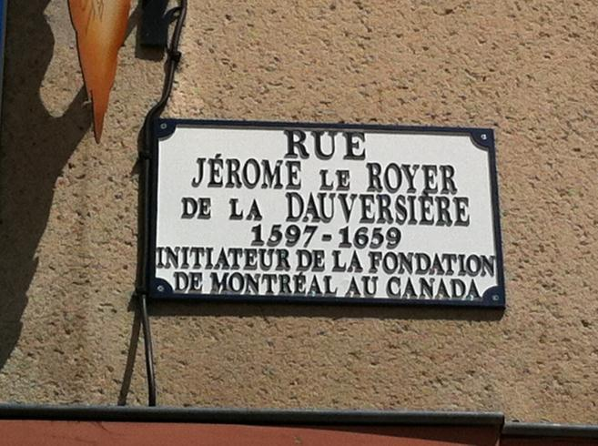
A street in La Flèche was name in honor of de la Dauversière

Slide 12
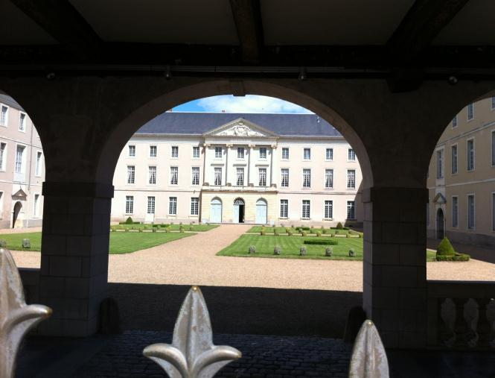
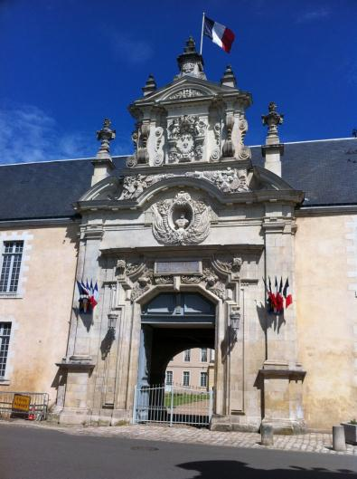
The Jesuit College in La Flèche, now a military college.
Many new comers to Nouvelle France were educated there including Monseigneur de Laval, Nouvelle France’s first Bishop.

Slide 13
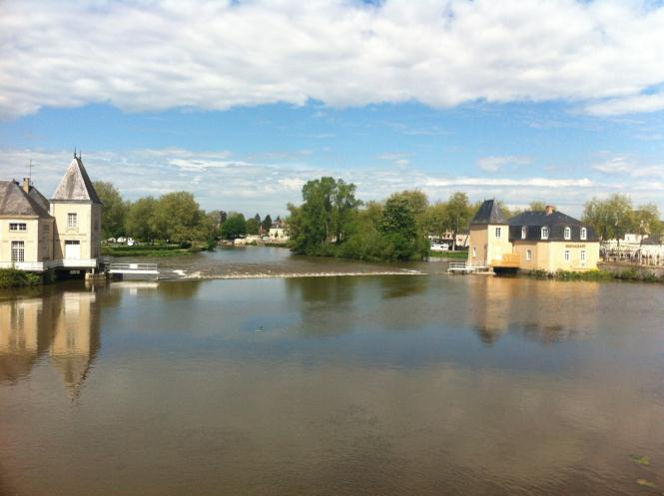
Le Loir river in La Flèche. The french settlers who formed part of La Grande Recrue (the great recruitment) of 1653 left from here for Nouvelle France including Louis “dit Le Sabotier” Guertin

Slide 14
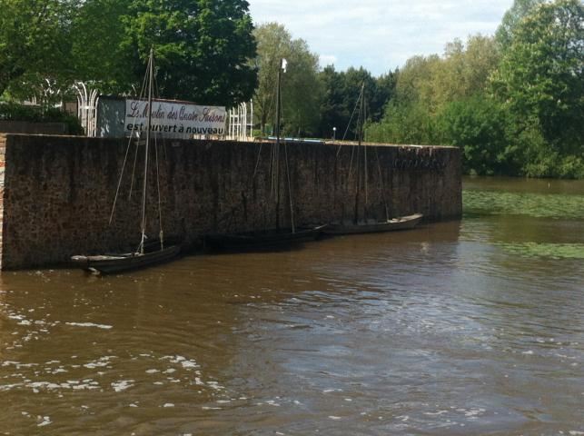
They would have used small boats such as these.

Slide 15
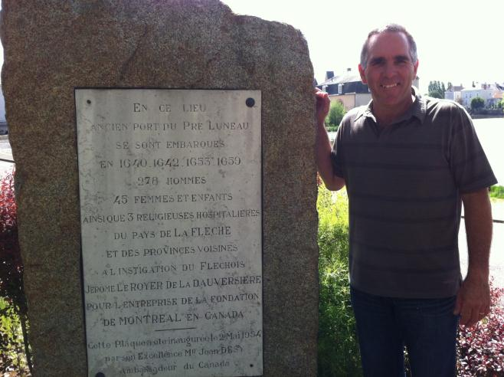
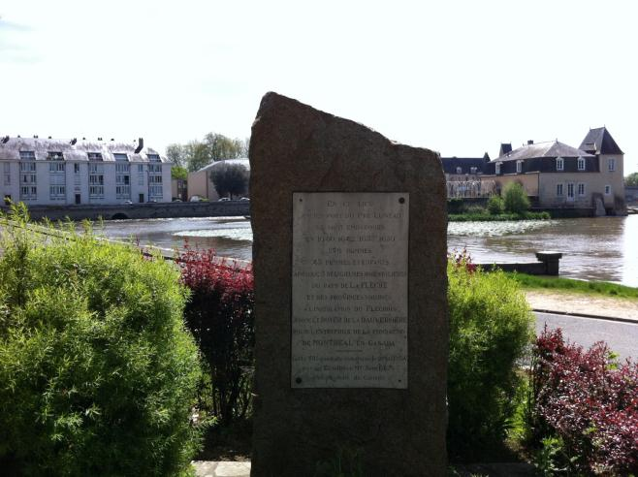
The monument located in Port Luneau in La Flèche to honor the French settlers who left for Nouvelle France as part of ‘La Grande Recrue’ of 1653

Slide 16
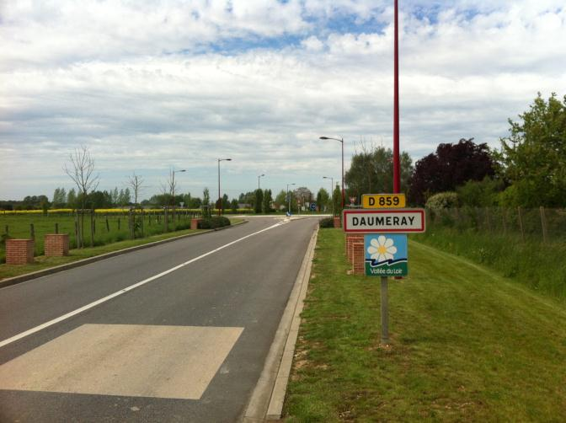
The village of Daumeray where Louis Guertin was born

Slide 17
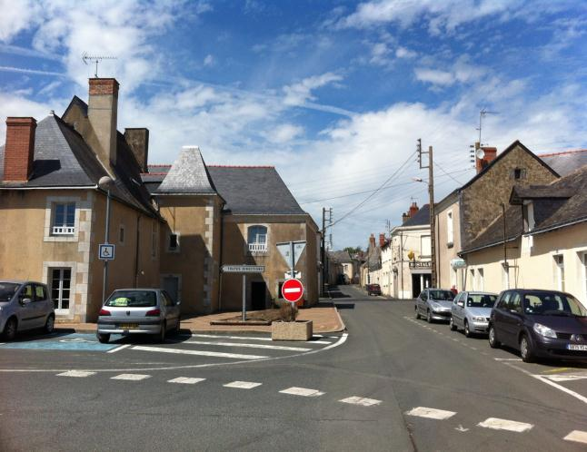
Village of Daumeray

Slide 18
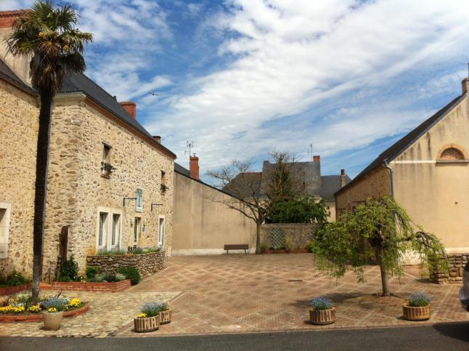
Mairie (town hall) of Daumeray and to the right the municipal council hall.

Slide 19
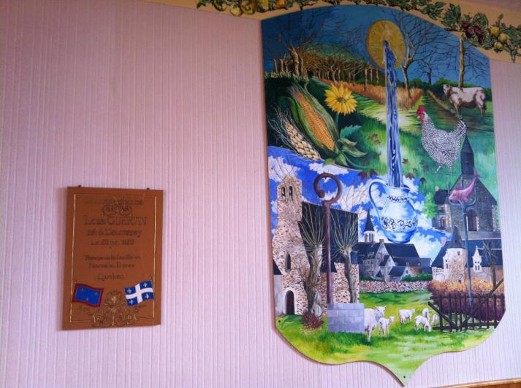
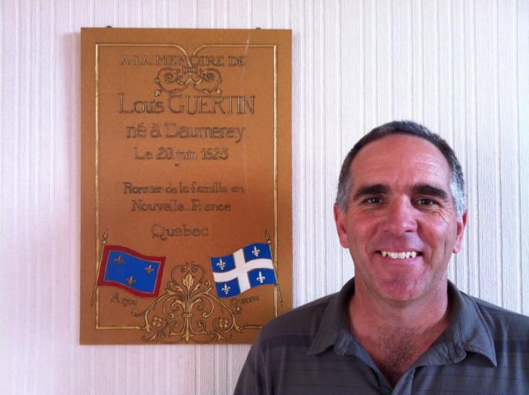
Plaque to honor Louis Guertin that the Daumeray council put up in the municipal council hall in1999.

Slide 20
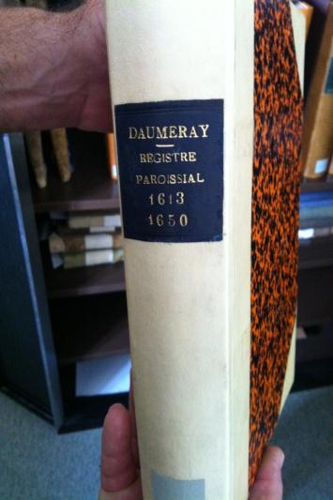
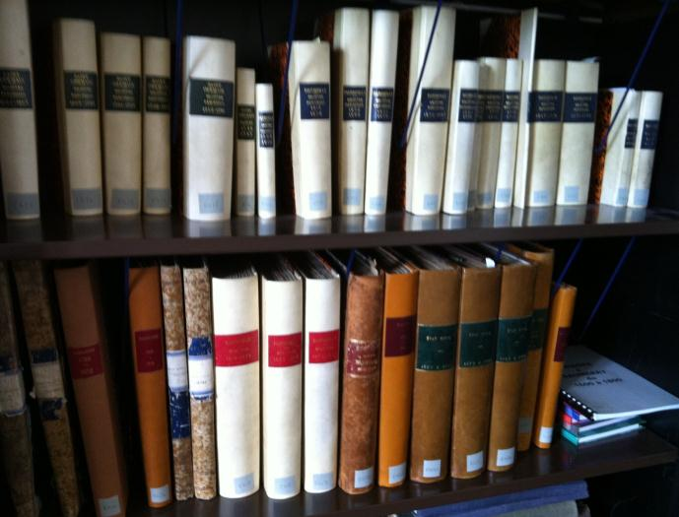
Daumeray town hall’s birth death and marriage registers. Some date back the the16^{th century}.

Slide 21
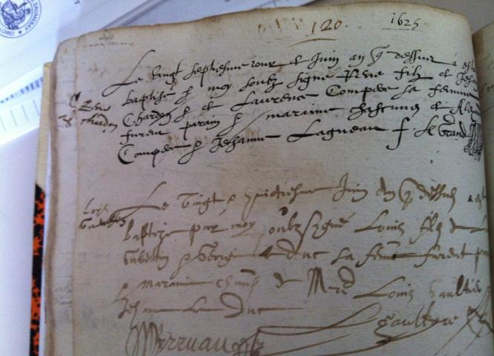
Louis Guertin’s birht register
28 June 1625.

Slide 22
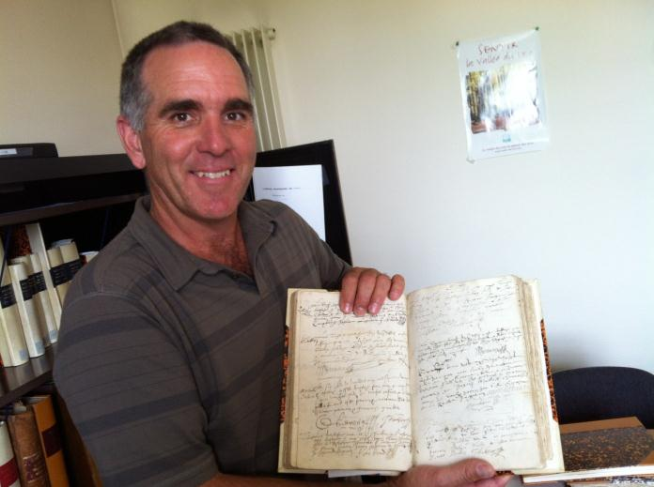
What a feeling to be holding such a historic document!

Slide 23
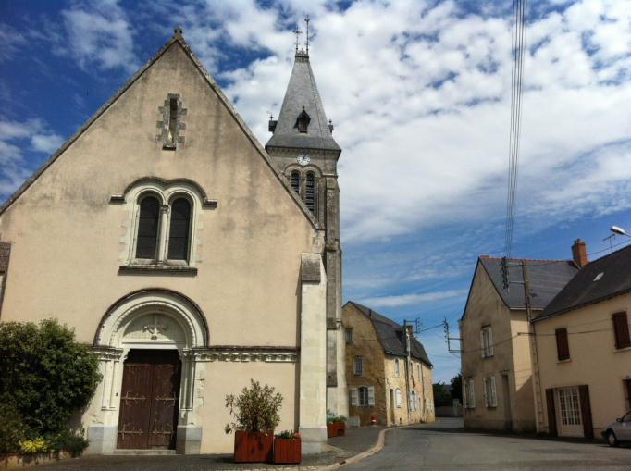
St-Martin’s church in Daumeray where Louis Guertin was baptised

Slide 24
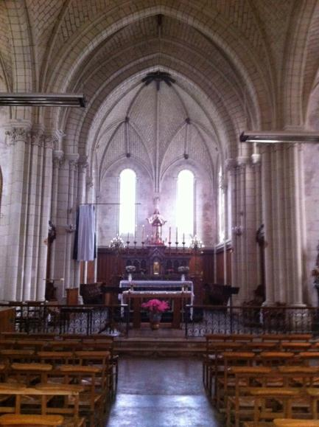
Inside St-Martin’s church

Slide 25
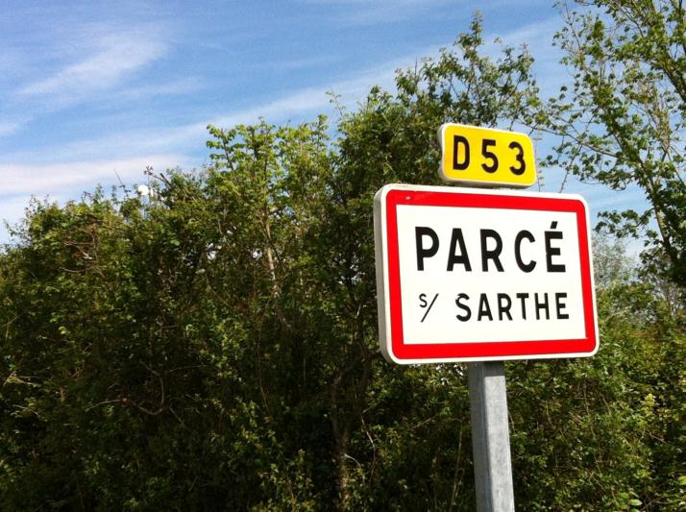

Slide 26
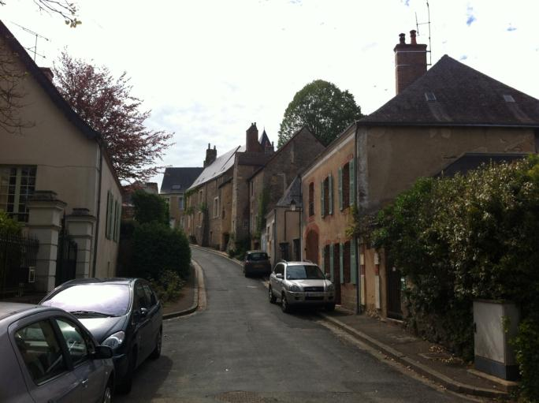
The village of Parcé-sur-Sarthe north of La Flèche where Louis Guertin was living at the time of his departure for Nouvelle France

Slide 27
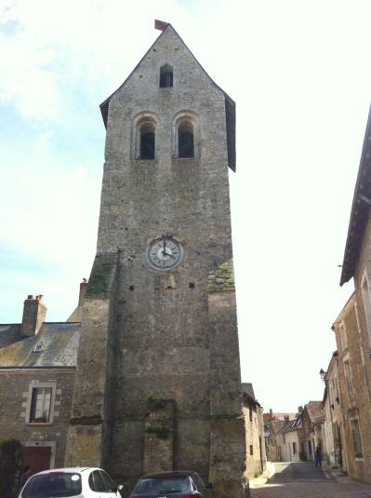
St-Pierre’s tower in the center of Parcé-sur-Sarthe. Built in the12th century.

Slide 28
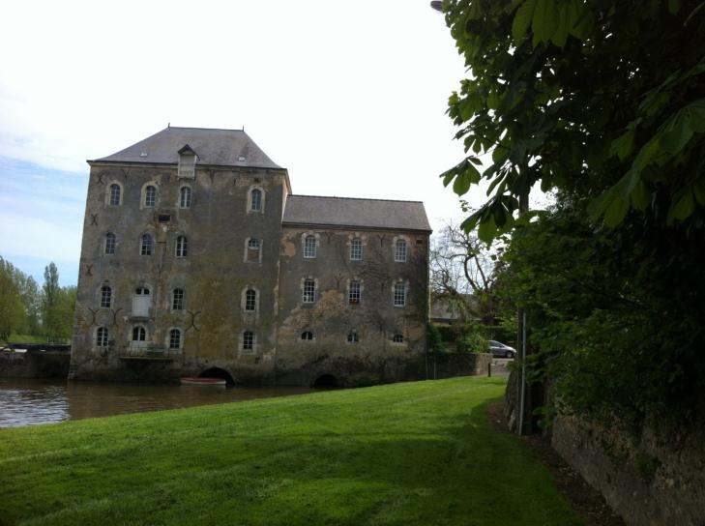
The old water mill on the Sarthe river in Parcè-sur-Sarthe.

Slide 29
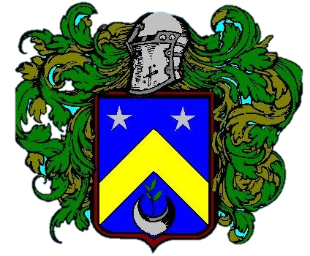
Fin

